Slide 1
Biometry and Security:
Secure Biometric Authentication for Weak Computational Devices
Author: Zelenevskiy Vladimir
Based on the research by M.J. Atallah and the others

Slide 2
Contents:
Biometry: common information
Purpose of the research
Attacks on the biometric data
Solution: general idea
Security model
Early protocols (“false starts”)
Scheme for secure authentication
Proof of the scheme security
Conclusions

Slide 3
Biometrics:
Biometrics is the science and technology of measuring and analyzing biological data.
In IT, biometrics refers to technologies that measure and analyze human body characteristics, such as fingerprints, eye retinas and irises, voice patterns, facial patterns and hand measurements, for authentication purposes.
[http://www.bitpipe.com]

Slide 4
Biometrical Data:
Two main groups:
  Physiological are related to the shape of the body.
  Behavioral are related to the behavior of a person.

Slide 5
Biometrical Identification:
Biometric identification schemes :
  face: unique facial characteristics
  fingerprint: an individual’s unique fingerprints
  hand geometry: the shape of the hand and the length of the fingers
  retina: the capillary vessels located at the back of the eye
  iris: the colored ring that surrounds the eye’s pupil analysis of the
  signature: the way a person signs his name.
  vein: pattern of veins in the back of the hand and the wrist
  voice: tone, pitch, cadence and frequency of a person’s voice.

Slide 6

Biometrics - advantages:
Highest level of security – “Who you are?”
Unforgeable authentication
Quickly and automatically

Slide 7

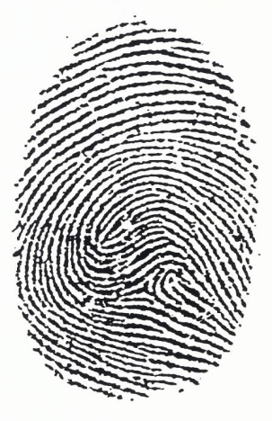
Biometrics - difficulties:
Privacy!
  Storage
  Transfer
Variables between measurements
  Encryption - ?
  Comparison - ?
  Hash-functions - ?
  1 2

Slide 8
Purpose of the research:
Highest level of security
Weak computational devices:
  Embedded processor
  Low memory capacity
  Battery-powered devices
Cryptographic hashes
---------------------------------------------------------------------------
NO: expensive cryptographic primitives and protocols
NO: relying on physical tamper-resistance
NO: single point of failure

Slide 9
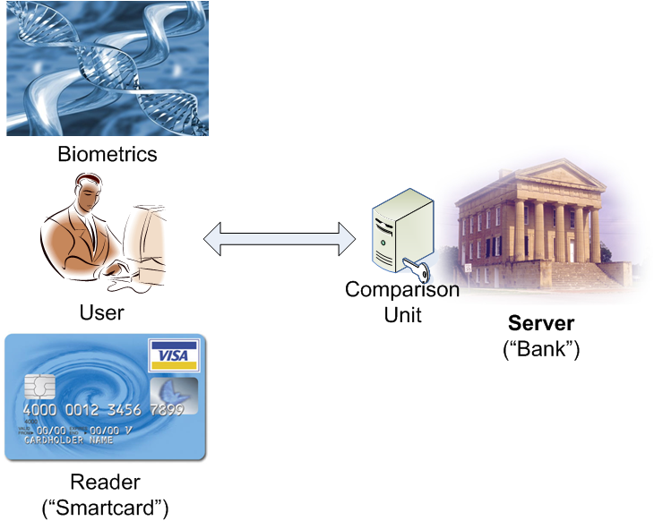
Project Terminology:

Slide 10
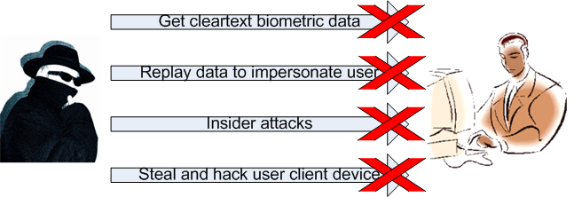
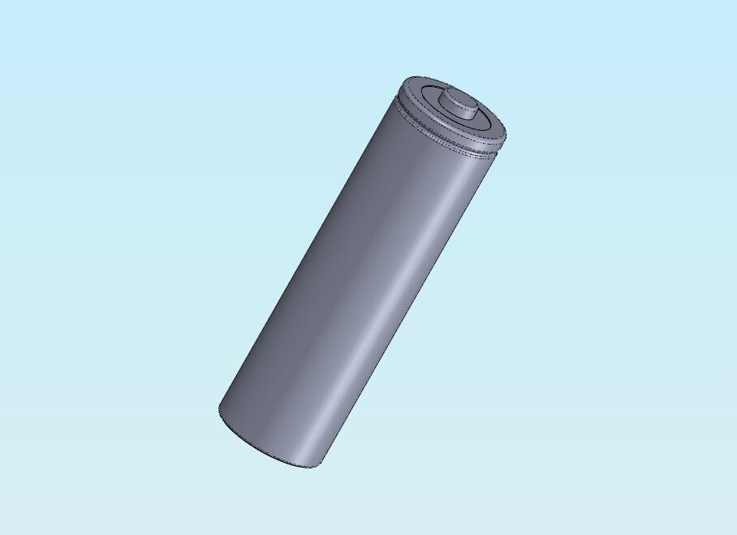
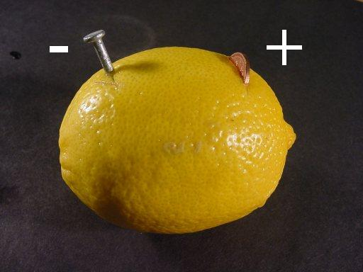
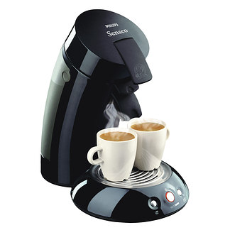
Necessary security:

Slide 11
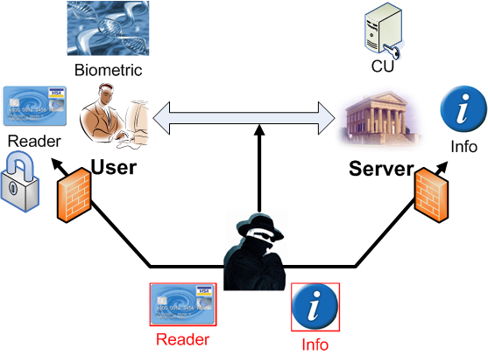
Security implementation:

Slide 12
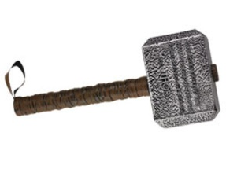

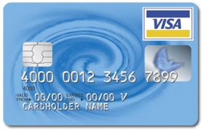
Solution requirements:
Inexpensive operations:
  The protocols use hash computation but not encryption
  No multiplication
No replay attacks are possible
Information obtained from the comparison unit cannot be used to impersonate the user
If the card is stolen and all its contents compromised, still the adversary cannot impersonate the user
Correctness
Privacy

Slide 13


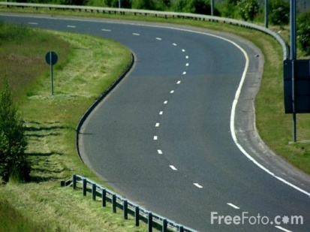
Security model: Definitions
Confidentiality
  Adversary should not be able to learn information about user’s biometry
Integrity
  Adversary should not be able to impersonate the client
Availability
  Adversary should not be able to make the client unable to login
13

Slide 14


Security model: Adversary
Adversary is defined by the resources that he has:
Smartcard
  Uncracked (SCU)
  Cracked (SCC)
Fingerprint (FP)
Eavesdrop
  Server Database (ESD): all user info on server
  Communication Channel (ECC): all info sent
  Comparison Unit (ECU): ESD + ECC + comparison result
Malicious (MCC): ECC + change values

Slide 15
Security model: Summary
Resources | Confidentiality | Integrity | Availability
Fingerprint | NO | STRONG | STRONG
Smartcard Cracked + Database | NO | NO | NO
Smartcard Uncracked + Fingerprint | NO | NO | NO
Malicious + Database | STRONG | NO | NO
Smartcard Uncracked + Malicious + Database | NO | NO | NO
Malicious | STRONG | STRONG | NO
Smartcard Uncracked | STRONG | STRONG | NO
Smartcard Uncracked + Comparison Unit | WEAK | WEAK | NO
13

Slide 16
Solution: Terminology
Binary vectors
Hamming distance
F0 - stored reference vector (server)
F1 – recently measured biometric vector (client)
Dist(F0 ,F1) – Hamming distance between F0 and F1
Identification: Dist(F0 ,F1) < Threshold
Correctness – the server correctly computes Dist(F0 ,F1)
Privacy – the protocol reveals nothing about F0 and F1
other than Hamming distance

Slide 17
Solution: Preliminary protocols 1&2
F1 – sent to the server in clear text (encrypted)
F0 - stored on the server in clear text (encrypted)
Disadvantages: Vulnerable to insider attacks on server
Correctness
Privacy
Server: stores h(F0||r) – hash of F0 and r – random vector
Client: computes and sends h(F1||r)
Cryptographic hashing does not preserve the distance between objects!
Correctness
Privacy
17

Slide 18
Solution: Preliminary protocols 3&4
Server: stores vector sum, R – vector known only to the client
Client: sends
Correctness Dist( , ) = Dist(F0, F1)
Privacy Information leakage on the server
Server: stores , П – fixed random permutation known only to the client
Client: computes and sends
Correctness Dist( , ) = Dist(F0,F1)
Privacy Some info leakage on the server,
because same П is used each time.
18
18

Slide 19
Final Solution: Boolean case
Server and Client:
small collection of values, recomputed each round
Q – number of copies of this info on server and client
Q – also a number of fingerprint mismatches before re-registration
Client:
Fi+1 – boolean vector from biometrics on client
Пi , Пi+1 – random permutations
Ri, Ri+1, Si, Si+1, Si+2 – random boolean vectors
Server:
, H(Si), H(Si, H(Si+1))
19
19

Slide 20
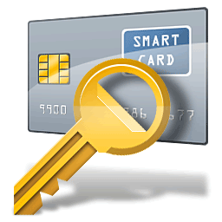

Final Solution: Boolean case
Round:
Reads: Fi+1
Generates: Ri+1, Si+1
, Si, T
        Computes: H(Si), compares it with stored H(Si) (yes: proceeds, no: aborts)
        XOR Si → →
        Computes: Dist ( , ) (yes: proceeds, no: aborts, info set –away)
20
20
20

Slide 21
Final Solution: Boolean case
H(T)
Checks: H(T) (No: error message)
Yes:
Deletes: Fi+1, Ri, Si
        Verifies:
        Updates storage:
21
21
21
21

Slide 22
Final Solution: Arbitrary case
Modification:
Fi , Fi+1 – arbitrary (non-binary) vectors
Distance function depends on | Fi - Fi+1 |
Si, Si+1, Si+2 – random boolean vectors
Ri, Ri+1 – random arbitrary vectors
Every is replaced by
The above requires: O((log∑)n), where ∑ - size of alphabet, n – number of items
Minimal information leakage (+ the values are permuted)
For function → Hamming distance computation.
Requires: O(∑n)
22
22
22

Slide 23
Security of the solution
Resources | Information
Fingerprint | F
Smartcard Uncracked | Ability to probe small number of fingerprints
Smartcard Cracked | SCU + Ri, Si, Пi, K
Database | K and several sets of H(Si), H(Si, H(Si+1)),
Communication channel | Several sets of
Comparison Unit | Database + Communication channel + distances of several readings
Malicious | Communication channel + can change values
23
3

Slide 24
Confidentiality:
Lemma 1: The pair of values and reveals nothing other than the distance between each pair of vectors.
Theorem 1: The only cases where an adversary learns the fingerprint are in:
  FP
  SCC + ESD
  SCU + ESD + MCC
  Any superset of this values
  and
  SCU + ECU – weakly learns fingerprint (can probe different fingerprints)

Slide 25
Integrity and Availability:
Theorem 2: The only cases where an adversary can impersonate a client:
    SCU +FP
    SCC + ESD
    MCC + ESD
    Any superset of this values
    And
    SCU + ECU – weakly impersonate the client
  The only cases where an adversary can attack the availability of the attack are in:
    SCU
    MCC
    Any superset of this values
25

Slide 26
Storage-Computation Tradeoff
Protocol:
q-fingerprint mismatches before re-registration
Requires:
O(1) – Storage
O(q) – hashes to authenticate
- x hashed j-times
Server: ,
Client: Пi, Ri, Si, Si+1
After t fingerprint mismatches:
26
26
26
26

Slide 27
Conclusion
Highest level of security
Weak computational devices:
  Embedded processor
  Low memory capacity
  Battery-powered devices
Cryptographic hashes
---------------------------------------------------------------------------
Additional requirements:
Client’s fingerprint is protected
For every successful identification the database must update its entry to the a new value.
Static database on server - ?
27
27
27

Slide 28

Thank you for your attention!
Any questions?
Author:
Zelenevskiy Vladimir,
zelenevs@informatik.uni-bonn.de

