Slide 1
Fuzzy Identity Based Signature
Based on P Yang et al 2008
Kittipat Virochsiri

Slide 2
Introduction
What is it?
Applications

Slide 3
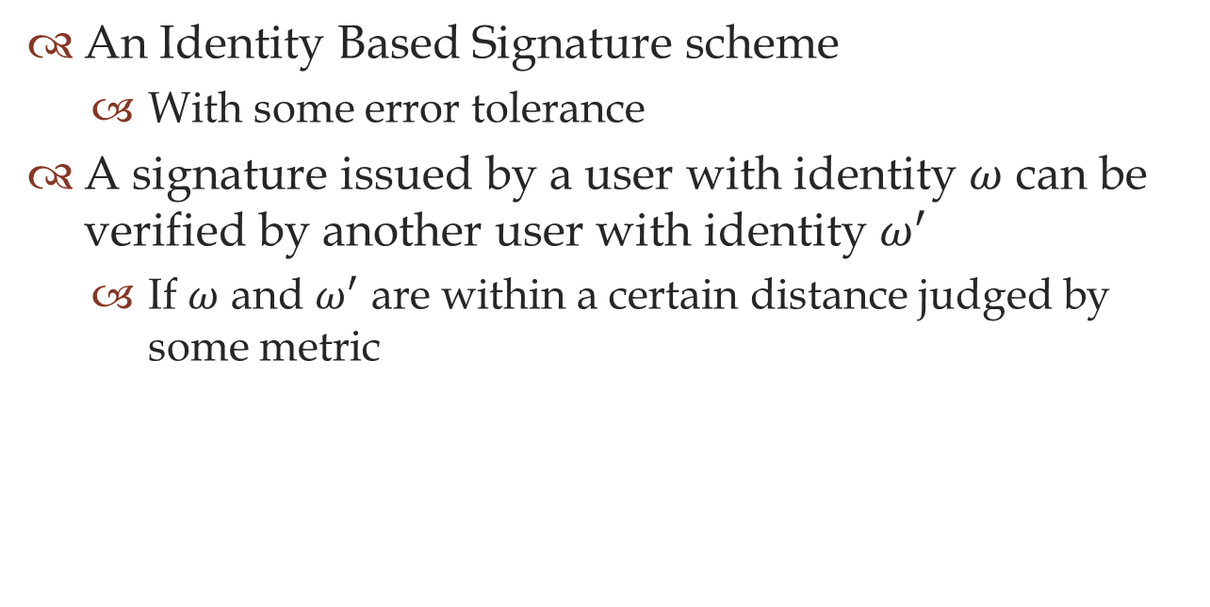
What is it?
An Identity Based Signature scheme
  With some error tolerance
A signature issued by a user with identity $ω$ can be verified by another user with identity $ω^{′}$
  If $ω$ and $ω^{′}$ are within a certain distance judged by some metric

Slide 4
Applications
Attribute-based signature
Biometric identity based signature

Slide 5
Preliminaries
Bilinear Pairing
Computational Diffie-Hellman
Threshold Secret Sharing Schemes

Slide 6
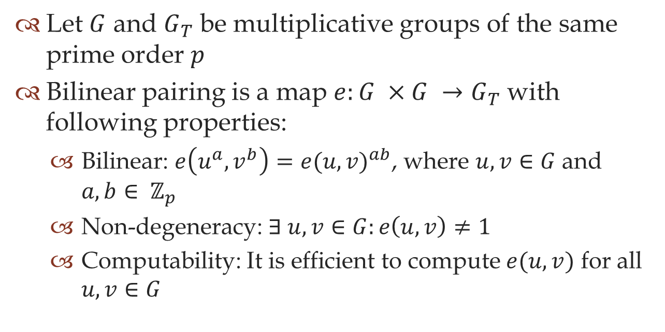
Bilinear pairing
Let $G$ and $G_{T}$ be multiplicative groups of the same prime order $p$
Bilinear pairing is a map $e:G ×G →G_{T}$ with following properties:
  Bilinear: $e\left(u^{a},v^{b}\right)=e(u,v)^{ab}$, where $u, v∈G$ and $a, b∈ ℤ_{p}$
  Non-degeneracy: $∃ u, v∈G:e\left(u, v\right)≠1$
  Computability: It is efficient to compute $e(u, v)$ for all $u, v∈G$

Slide 7
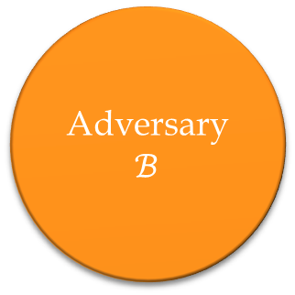



Computational Diffie-Hellman (CDH)
Challenger $𝒞$
Adversary $ℬ$
$$\left(g, A=g^{a}, B=g^{b}\right)$$
$$g^{ab}∈𝔾$$

Slide 8
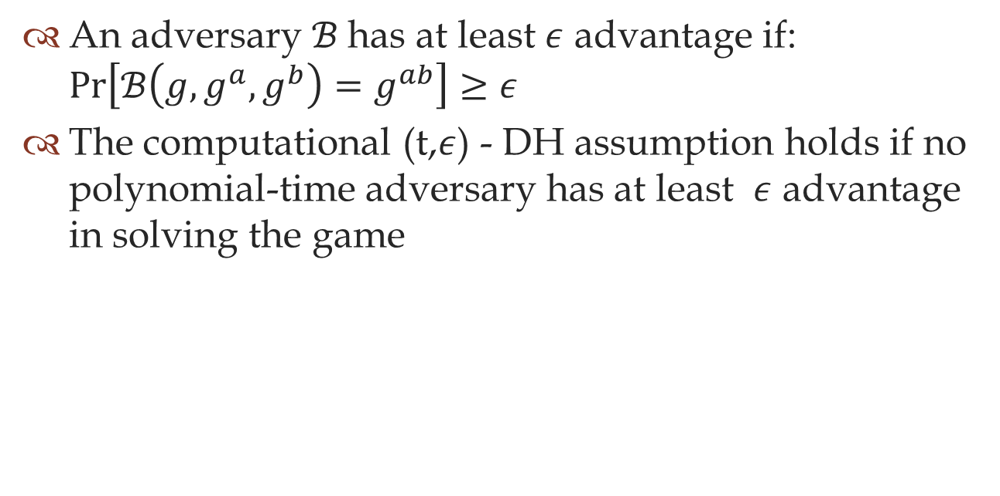
CDH Assumption
An adversary $ℬ$has at least $ε$ advantage if: $\operatorname{Pr}\left[ℬ\left(g,g^{a},g^{b}\right)=g^{ab}\right]≥ε$
The computational (t,$ε$) - DH assumption holds if no polynomial-time adversary has at least $ε$ advantage in solving the game

Slide 9
Threshold Secret Sharing Scheme

Slide 10
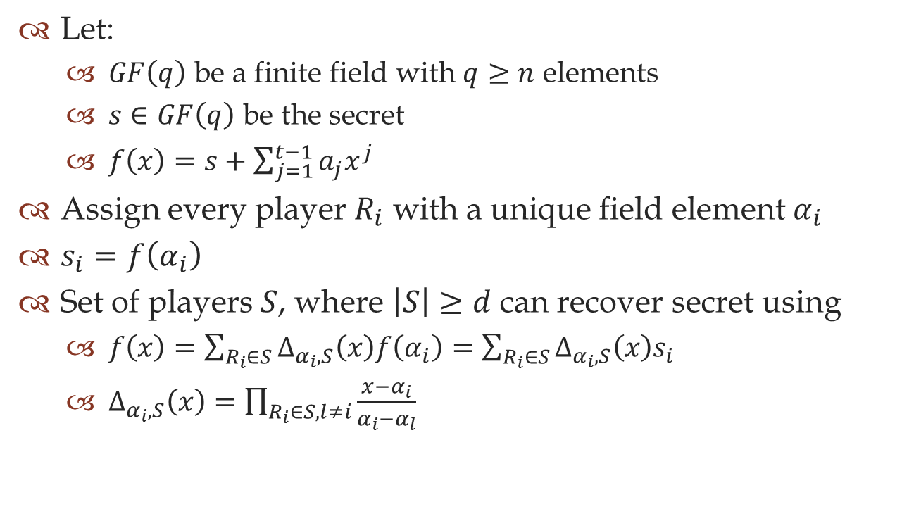
Threshold Secret Sharing Scheme
Let:
  $GF\left(q\right)$ be a finite field with $q≥n$ elements
  $s∈GF\left(q\right)$ be the secret
  $f\left(x\right)=s+\sum_{j=1}^{t−1}{a_{j}x^{j}}$
Assign every player $R_{i}$ with a unique field element $α_{i}$
$s_{i}=f\left(α_{i}\right)$
Set of players $S$, where $\left|S\right|≥d$ can recover secret using
  $f\left(x\right)=\sum_{R_{i}∈S}{Δ_{α_{i},S}\left(x\right)f\left(α_{i}\right)}=\sum_{R_{i}∈S}{Δ_{α_{i},S}\left(x\right)s_{i}}$
  $Δ_{α_{i},S}\left(x\right)=\prod_{R_{i}∈S,l≠i}{\frac{x−α_{i}}{α_{i}−α_{l}}}$

Slide 11
Fuzzy Identity Based Signature (FIBS) scheme
Consisted of 4 steps:
Setup
Extract
Sign
Verify

Slide 12








FIBS schemes
$$1^{k}$$
$$M$$
Setup
$$params$$
Sign
$$mk$$
$$σ$$
$$ID$$
Extract
Verify
$$ID′$$
$$D_{ID}$$
0/1

Slide 13
Security Model
Unforgeable Fuzzy Identity Based Signature against Chosen-Message Attack (UF-FIBS-CMA)

Slide 14








Security Model
Setup
Signing Oracle
$$α$$
$$\left(M_{i},α \right)$$
$$params$$
$$σ_{i}$$
Adversary $𝒜$
$$γ_{i}, \left|γ_{i}∩α^{∗}\right|<d$$
Private Key Oracle
$$K_{γ_{i}}$$
$σ^{∗}$ for $(M^{∗},α)$

Slide 15

Assumption
Let $𝒜$ be an adversary assumed to be a probabilistic Turing machine taking as input a security parameters $k$

Slide 16

The game – Setup Phase
Challenger $𝒞$
  runs the setup phase of the algorithm
  tells adversary $𝒜$ the public parameters

Slide 17

The game – Phase 1
$𝒜$
  issues private key queries and signature queries for any identities $γ_{i}$ adaptively

Slide 18

The game – Phase 2
$𝒜$
  declares the target identity $α$
    $\left|α∩γ_{i}\right|<d$ for all $γ_{i}$ from Phase 1

Slide 19

The game – Phase 3
$𝒜$
  issues private key queries for many identities $γ_{j}$
    $∀γ_{j}, \left|γ_{j}∩α\right|<d$
  issues signature queries for any identities

Slide 20

The game – Phase 4
$𝒜$
  outputs $\left(α, \tilde{M},\tilde{σ}\right)$
    $\tilde{σ}$ is $α$’s valid signature on the message $\tilde{M}$
  does not make a signature query on $\tilde{M}$ for identity $α$

Slide 21
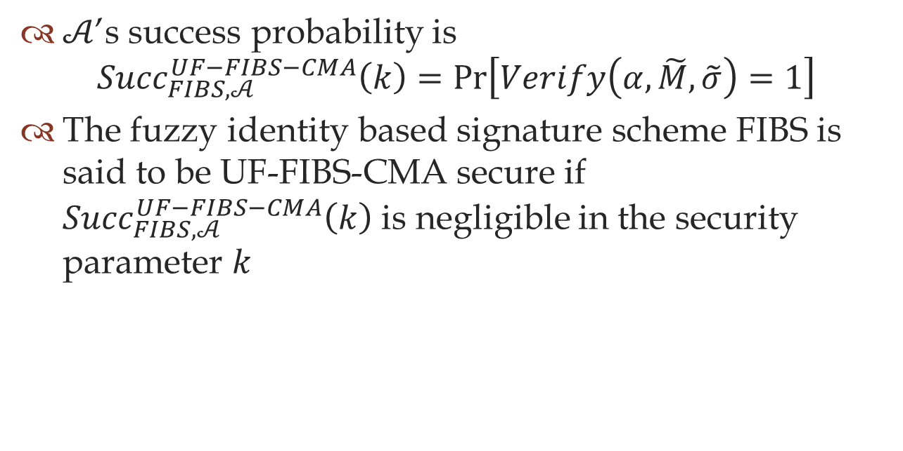
Definition
$𝒜$’s success probability is
${Succ}_{FIBS,𝒜}^{UF−FIBS−CMA}\left(k\right)=\operatorname{Pr}\left[Verify\left(α,\tilde{M},\tilde{σ}\right)=1\right]$
The fuzzy identity based signature scheme FIBS is said to be UF-FIBS-CMA secure if ${Succ}_{FIBS,𝒜}^{UF−FIBS−CMA}\left(k\right)$ is negligible in the security parameter $k$

Slide 22
Note
Fuzzy Identity-Based Encryption (FIBE) is
  as hard as decisional bilinear Diffie-Hellman
  Chosen Chiphertext Attack secure
FIBS is derived from FIBE and uses bilinear map
Therefore, FIBS is
  as hard as the weaker CDH
  UF-CMA secure

Slide 23
The Scheme

Slide 24




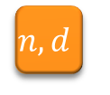


FIBS schemes
$$1^{k}$$
$$n,d$$
$$M$$
Setup
$$params$$
Sign
$$PP$$
$$mk$$
$$MK$$
$$σ$$
$$S$$
$$ID$$
Extract
Verify
$$ω$$
$$ID′$$
$$ω′$$
$$D_{ID}$$
$$K_{ω}$$
invalid/valid
0/1

Slide 25
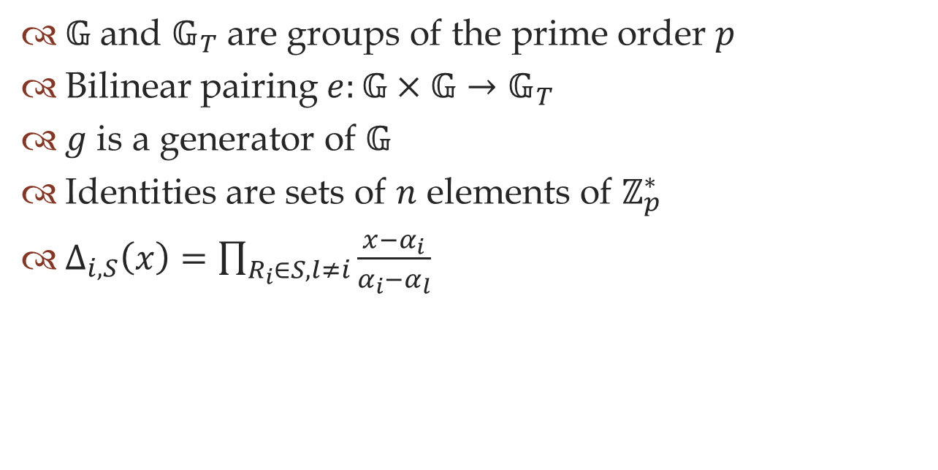
Building Blocks
$𝔾$ and $𝔾_{T}$ are groups of the prime order $p$
Bilinear pairing $e:𝔾×𝔾→𝔾_{T}$
$g$ is a generator of $𝔾$
Identities are sets of $n$ elements of $ℤ_{p}^{∗}$
$Δ_{i,S}\left(x\right)=\prod_{R_{i}∈S,l≠i}{\frac{x−α_{i}}{α_{i}−α_{l}}}$

Slide 26

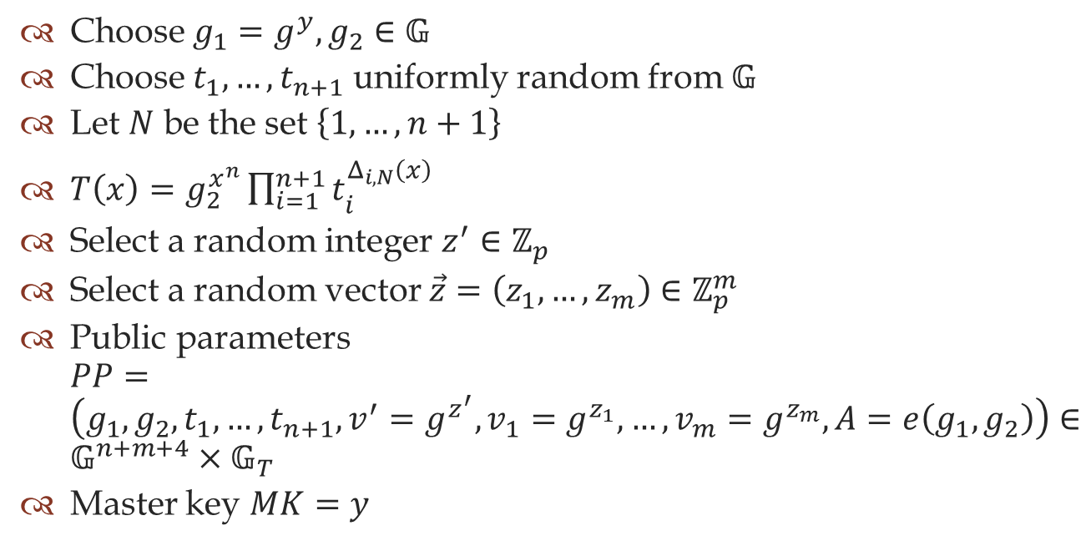
Setup$\left(n,d\right)$
Choose $g_{1}=g^{y},g_{2}∈𝔾$
Choose $t_{1},…,t_{n+1}$ uniformly random from $𝔾$
Let $N$ be the set $\left\{1,…,n+1\right\}$
$T\left(x\right)=g_{2}^{x^{n}}\prod_{i=1}^{n+1}{t_{i}^{Δ_{i,N}\left(x\right)}}$
Select a random integer $z^{′}∈ℤ_{p}$
Select a random vector $\vec{z}=\left(z_{1},…,z_{m}\right)∈ℤ_{p}^{m}$
Public parameters $PP=\left(g_{1},g_{2},t_{1},…,t_{n+1},v^{′}=g^{z^{′}},v_{1}=g^{z_{1}},…,v_{m}=g^{z_{m}},A=e\left(g_{1},g_{2}\right)\right)∈𝔾^{n+m+4}×𝔾_{T}$
Master key $MK=y$

Slide 27

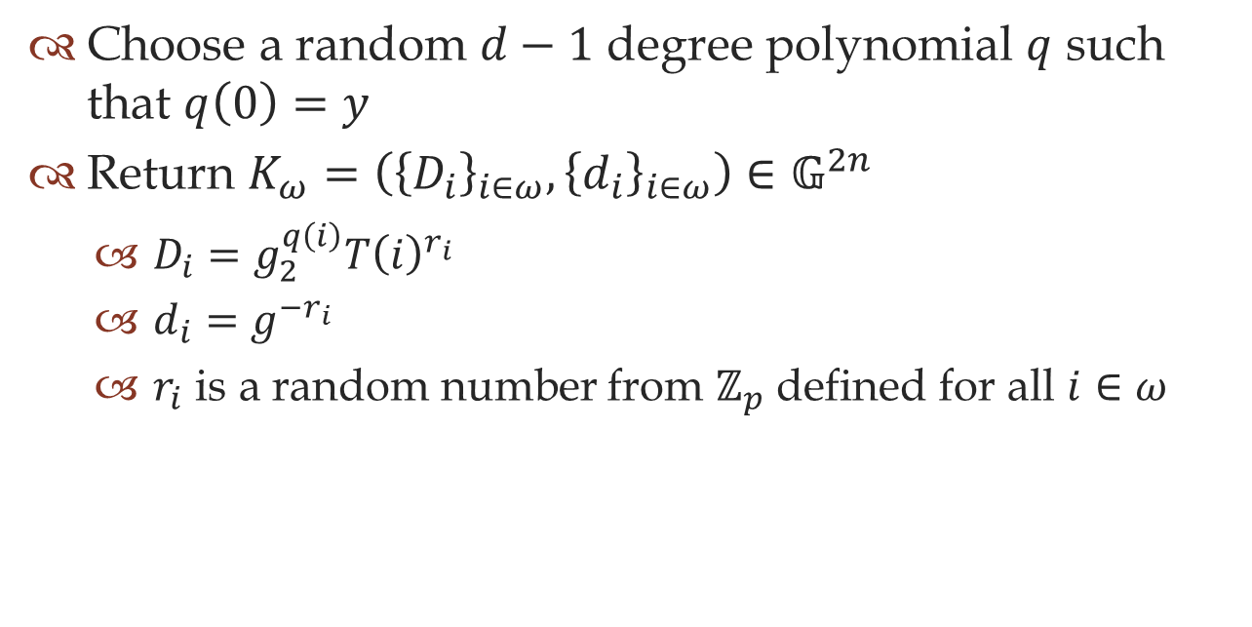
Extract$\left(PP,MK,ω\right)$
Choose a random $d−1$ degree polynomial $q$ such that $q\left(0\right)=y$
Return $K_{ω}=\left({\left\{D_{i}\right\}}_{i∈ω},{\left\{d_{i}\right\}}_{i∈ω}\right)∈𝔾^{2n}$
  $D_{i}=g_{2}^{q\left(i\right)}T{\left(i\right)}^{r_{i}}$
  $d_{i}=g^{−r_{i}}$
  $r_{i}$ is a random number from $ℤ_{p}$ defined for all $i∈ω$

Slide 28

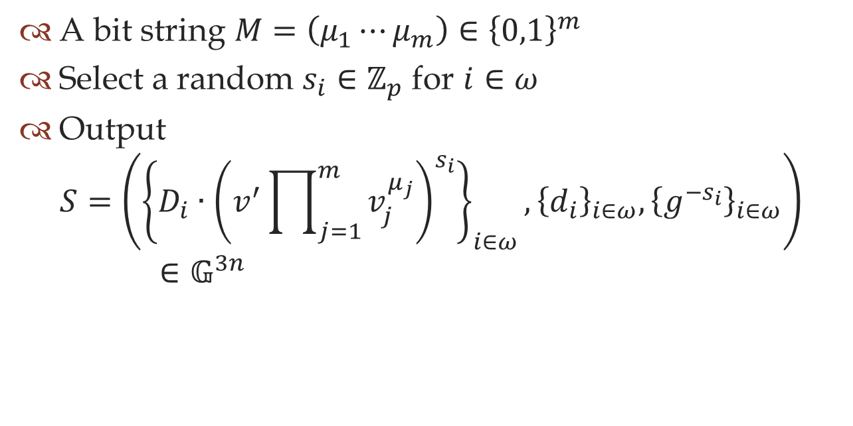
Sign$\left(PP,K_{ω},M\right)$
A bit string $M=\left(μ_{1}⋯μ_{m}\right)∈{\left\{0,1\right\}}^{m}$
Select a random $s_{i}∈ℤ_{p}$ for $i∈ω$
Output
$S=\left({\left\{D_{i}∙{\left(v^{′}\prod_{j=1}^{m}{v_{j}^{μ_{j}}}\right)}^{s_{i}}\right\}}_{i∈ω},{\left\{d_{i}\right\}}_{i∈ω}, {\left\{g^{−s_{i}}\right\}}_{i∈ω}\right)∈𝔾^{3n}$

Slide 29

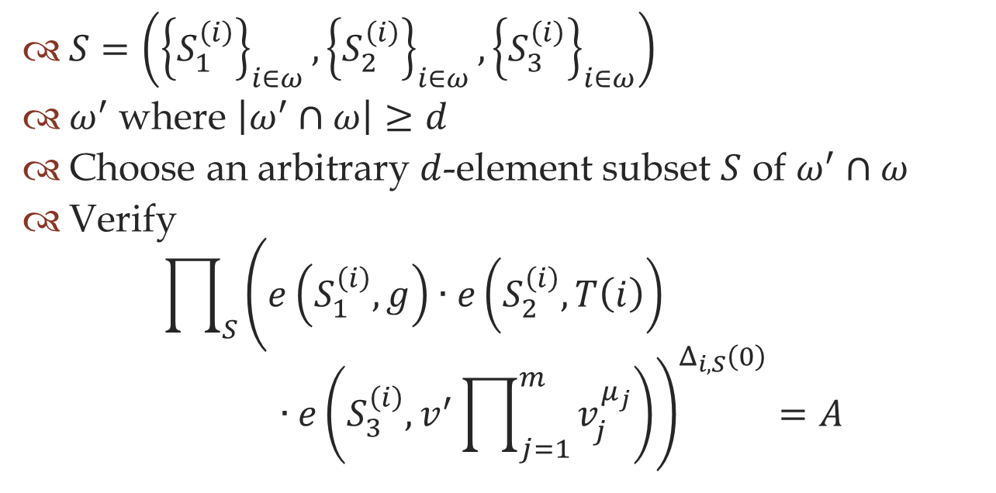
Verify$\left(PP,ω^{′},M,σ\right)$
$S=\left({\left\{S_{1}^{\left(i\right)}\right\}}_{i∈ω},{\left\{S_{2}^{\left(i\right)}\right\}}_{i∈ω},{\left\{S_{3}^{\left(i\right)}\right\}}_{i∈ω}\right)$
$ω^{′}$ where $\left|ω^{′}∩ω\right|≥d$
Choose an arbitrary $d$-element subset $S$ of $ω^{′}∩ω$
Verify
$\prod_{S}{{\left(e\left(S_{1}^{\left(i\right)},g\right)∙e\left(S_{2}^{\left(i\right)},T\left(i\right)\right)∙e\left(S_{3}^{\left(i\right)},v^{′}\prod_{j=1}^{m}{v_{j}^{μ_{j}}}\right)\right)}^{Δ_{i,S}\left(0\right)}=A}$

Slide 30

Correctness check
$\prod_{S}{{\left(e\left(S_{1}^{\left(i\right)},g\right)∙e\left(S_{2}^{\left(i\right)},T\left(i\right)\right)∙e\left(S_{3}^{\left(i\right)},v^{′}\prod_{j=1}^{m}{v_{j}^{μ_{j}}}\right)\right)}^{Δ_{i,S}\left(0\right)}}$
$\prod_{S}{{\left(e\left(g_{2}^{q\left(i\right)}∙T{\left(i\right)}^{r_{i}}∙{\left(v^{′}\prod_{j=1}^{m}{v_{j}^{μ_{j}}}\right)}^{s_{i}},g\right)∙e\left(g^{−r_{i}},T\left(i\right)\right)∙e\left(g^{−s_{i}},v^{′}\prod_{j=1}^{m}{v_{j}^{μ_{j}}}\right)\right)}^{Δ_{i,S}\left(0\right)}}$
$\prod_{S}{{\left(e\left(g_{2}^{q\left(i\right)},g\right)∙e\left(T{\left(i\right)}^{r_{i}},g\right)∙e\left({\left(v^{′}\prod_{j=1}^{m}{v_{j}^{μ_{j}}}\right)}^{s_{i}},g\right)∙e\left(g^{−r_{i}},T\left(i\right)\right)∙e\left(g^{−s_{i}},v^{′}\prod_{j=1}^{m}{v_{j}^{μ_{j}}}\right)\right)}^{Δ_{i,S}\left(0\right)}}$
$\prod_{S}{{\left(e\left(g_{2}^{q\left(i\right)},g\right)\right)}^{Δ_{i,S}\left(0\right)}}$
$e\left(g_{2},\prod_{S}{g^{q\left(i\right)Δ_{i,S}\left(0\right)}}\right)$
$e\left(g_{2},g^{\prod_{S}{q\left(i\right)Δ_{i,S}\left(0\right)}}\right)$
$e\left(g_{2},g^{q\left(0\right)}\right)$
$e\left(g_{2},g^{y}\right)$
$e\left(g_{2},g_{1}\right)$
$e\left(g_{1},g_{2}\right)$

Slide 31
Security Proof

Slide 32





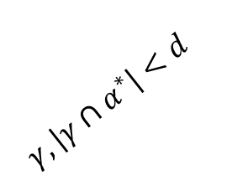



Security Game
Setup
Signing Oracle
$$α^{∗}$$
$$\left(M,α^{∗}\right)$$
$$params$$
$$σ$$
Adversary $𝒜$
$$γ, \left|γ∩α^{∗}\right|<d$$
Private Key Oracle
$$K_{γ}$$
$σ^{∗}$ for $(M^{∗},α)$
Simulator $ℬ$
$$\left(g,g^{a},g^{b}\right)$$
$$g^{ab}$$

Slide 33
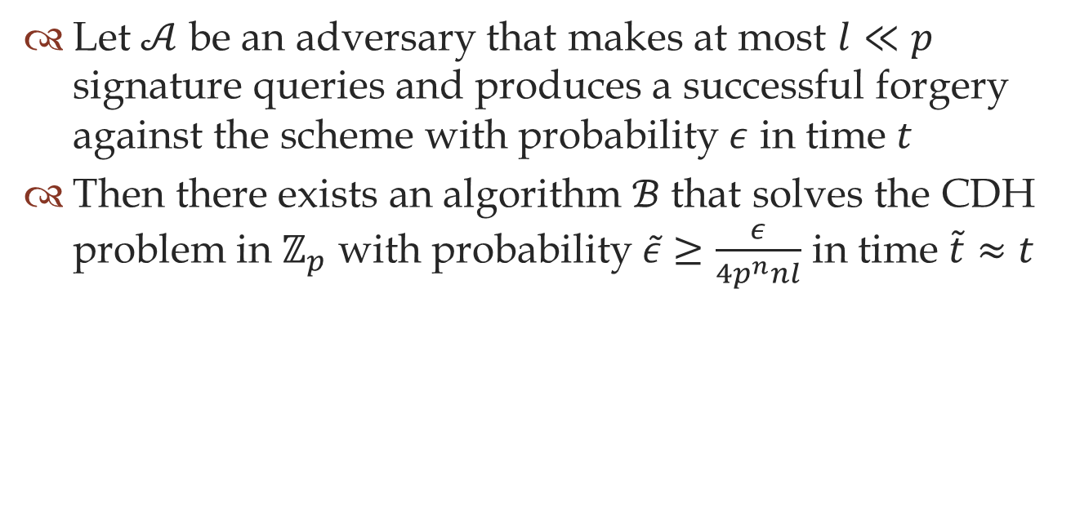
Theorem
Let $𝒜$ be an adversary that makes at most $l≪p$ signature queries and produces a successful forgery against the scheme with probability $ε$ in time $t$
Then there exists an algorithm $ℬ$ that solves the CDH problem in $ℤ_{p}$ with probability $\tilde{ε}≥\frac{ε}{4p^{n}nl}$ in time $\tilde{t}≈t$

Slide 34

Goal
The simulator $ℬ$ is given an instance $\left(g,g^{a},g^{b}\right)∈𝔾^{3}$ of the CDH problem
Must produce $g^{ab}$

Slide 35
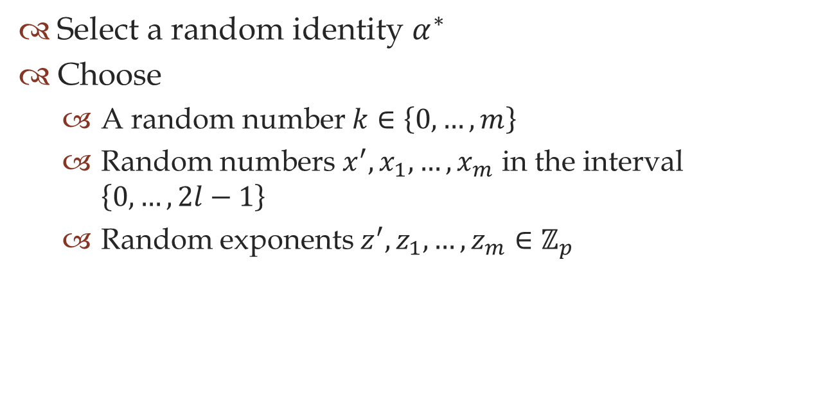
Setup
Select a random identity $α^{∗}$
Choose
  A random number $k∈\left\{0,…,m\right\}$
  Random numbers $x^{′},x_{1},…,x_{m}$ in the interval $\left\{0,…,2l−1\right\}$
  Random exponents $z^{′},z_{1},…,z_{m}∈ℤ_{p}$

Slide 36
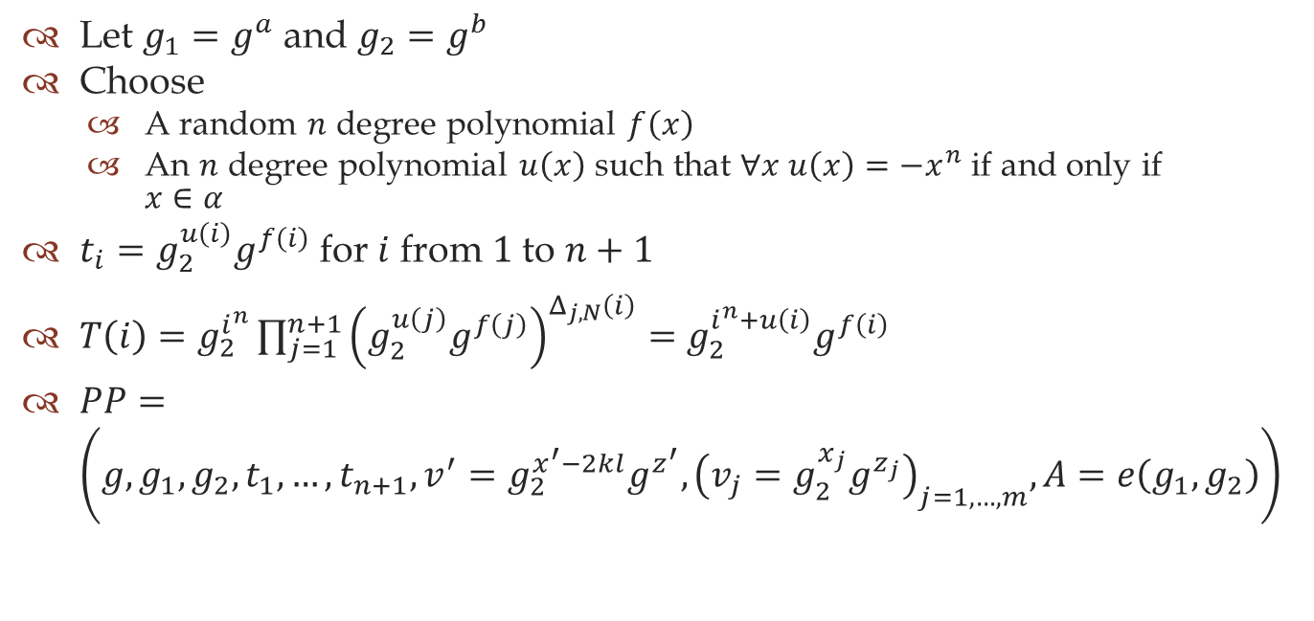
Setup
Let $g_{1}=g^{a}$ and $g_{2}=g^{b}$
Choose
  A random $n$ degree polynomial $f\left(x\right)$
  An $n$ degree polynomial $u\left(x\right)$ such that $∀x u\left(x\right)=−x^{n}$ if and only if $x∈α$
$t_{i}=g_{2}^{u\left(i\right)}g^{f\left(i\right)}$ for $i$ from $1$ to $n+1$
$T\left(i\right)=g_{2}^{i^{n}}\prod_{j=1}^{n+1}{{\left(g_{2}^{u\left(j\right)}g^{f\left(j\right)}\right)}^{Δ_{j,N}\left(i\right)}}=g_{2}^{i^{n}+u\left(i\right)}g^{f\left(i\right)}$
$PP=\left(g,g_{1},g_{2},t_{1},…,t_{n+1},v^{′}=g_{2}^{x^{′}−2kl}g^{z^{′}},{\left(v_{j}=g_{2}^{x_{j}}g^{z_{j}}\right)}_{j=1,…,m},A=e\left(g_{1},g_{2}\right)\right)$

Slide 37

Private Key Oracle
Answer private key query on identity $γ$
  $\left|γ∩α^{∗}\right|<d$
Define $Γ$, $Γ^{′}$, $S$
  $Γ=γ∩α$
  $Γ⊆Γ^{′}⊆γ$ and $\left|Γ^{′}\right|=d−1$
  $S=Γ^{′}∪\left\{0\right\}$

Slide 38
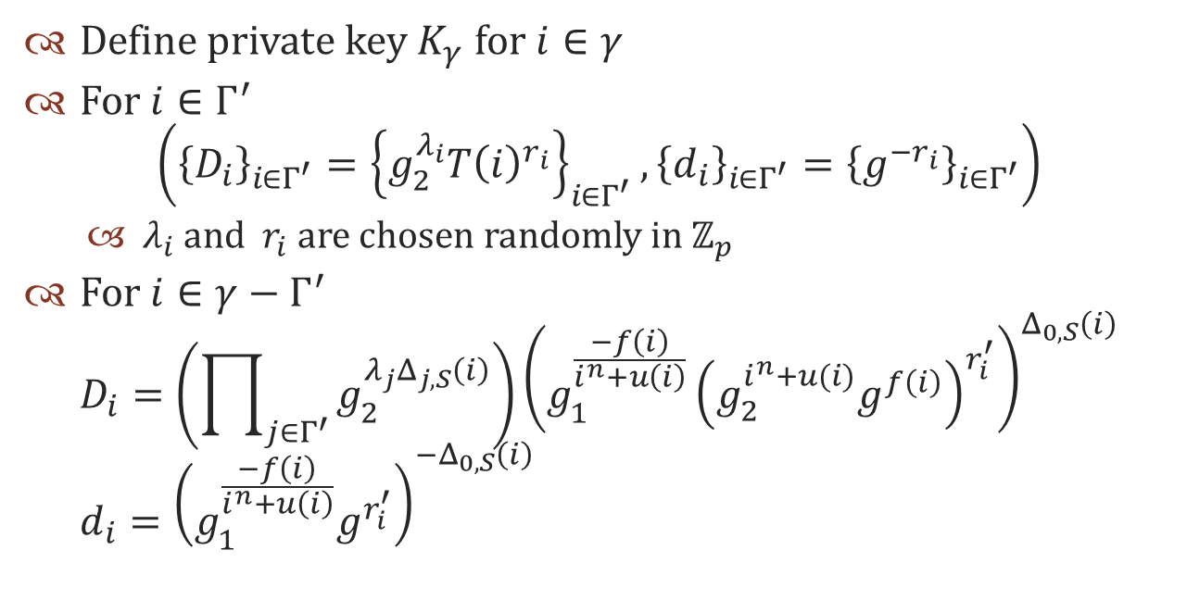
Private Key Oracle
Define private key $K_{γ}$ for $i∈γ$
For $i∈Γ^{′}$
$\left({\left\{D_{i}\right\}}_{i∈Γ^{′}}={\left\{g_{2}^{λ_{i}}T{\left(i\right)}^{r_{i}}\right\}}_{i∈Γ^{′}},{\left\{d_{i}\right\}}_{i∈Γ^{′}}={\left\{g^{−r_{i}}\right\}}_{i∈Γ^{′}}\right)$
  $λ_{i}$ and $r_{i}$ are chosen randomly in $ℤ_{p}$
For $i∈γ−Γ^{′}$
$D_{i}=\left(\prod_{j∈Γ^{′}}{g_{2}^{λ_{j}Δ_{j,S}\left(i\right)}}\right){\left(g_{1}^{\frac{−f\left(i\right)}{i^{n}+u\left(i\right)}}{\left(g_{2}^{i^{n}+u(i)}g^{f\left(i\right)}\right)}^{r_{i}^{′}}\right)}^{Δ_{0,S}\left(i\right)}$
$d_{i}={\left(g_{1}^{\frac{−f\left(i\right)}{i^{n}+u\left(i\right)}}g^{r_{i}^{′}}\right)}^{{−Δ}_{0,S}\left(i\right)}$

Slide 39
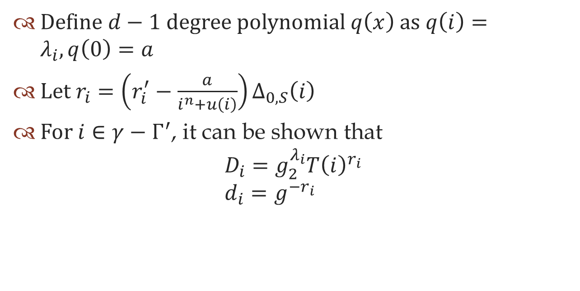
Private Key Oracle
Define $d−1$ degree polynomial $q\left(x\right)$ as $q\left(i\right)=λ_{i}, q\left(0\right)=a$
Let $r_{i}=\left(r_{i}^{′}−\frac{a}{i^{n}+u\left(i\right)}\right)Δ_{0,S}\left(i\right)$
For $i∈γ−Γ^{′}$, it can be shown that
$D_{i}=g_{2}^{λ_{i}}T{\left(i\right)}^{r_{i}}$
$d_{i}=g^{−r_{i}}$

Slide 40
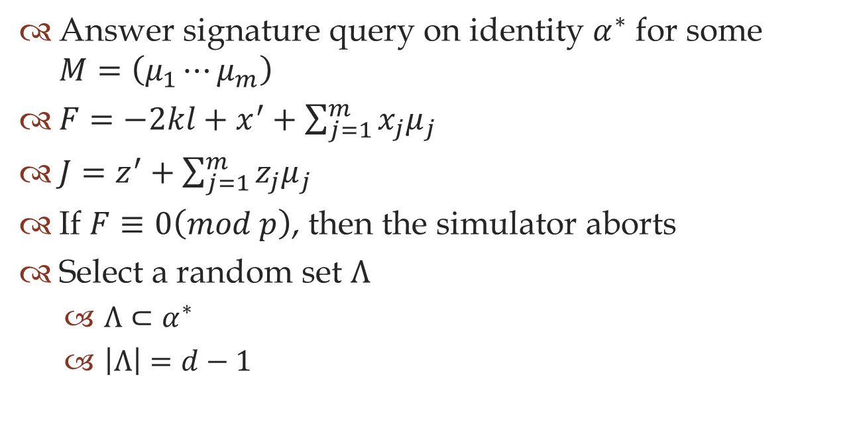
Signing Oracle
Answer signature query on identity $α^{∗}$ for some $M=\left(μ_{1}⋯μ_{m}\right)$
$F=−2kl+x^{′}+\sum_{j=1}^{m}{x_{j}μ_{j}}$
$J=z^{′}+\sum_{j=1}^{m}{z_{j}μ_{j}}$
If $F≡0\left(mod p\right)$, then the simulator aborts
Select a random set $Λ$
  $Λ⊂α^{∗}$
  $\left|Λ\right|=d−1$

Slide 41

Signing Oracle
For $i∈Λ$
$g^{q^{′}\left(i\right)}=g^{λ_{i}^{′}}$
  $λ_{i}^{′}$ is chosen randomly in $ℤ_{p}$
For $i∈α^{∗}−Λ$
$g^{q^{′}\left(i\right)}=\left(\prod_{j=1}^{d−1}{g^{λ_{j}^{′}Δ_{j,α^{∗}}\left(i\right)}}\right)g^{aΔ_{0,α^{∗}}\left(i\right)}$

Slide 42

Signing Oracle
Pick random $r_{i}$, $s_{i}$ for $i∈α^{∗}$
Compute
$S_{1}^{\left(i\right)}={\left(g^{q^{′}\left(i\right)}\right)}^{−\frac{J}{F}}g^{f\left(i\right)r_{i}}{\left(g^{J}g_{2}^{F}\right)}^{s_{i}}$
$S_{2}^{\left(i\right)}=g^{−r_{i}}$
$S_{3}^{\left(i\right)}={\left(g^{q^{′}\left(i\right)}\right)}^{\frac{1}{F}}g^{−s_{i}}$

Slide 43

Signing Oracle
For $\tilde{s}=s_{i}−\frac{q^{′}\left(i\right)}{F}$, it can be shown that
$S_{1}^{(i)}=g_{2}^{q^{′}\left(i\right)}T{\left(i\right)}^{r_{i}}{\left(v^{′}\prod_{j=1}^{m}{v_{j}^{μ_{j}}}\right)}^{{\tilde{s}}_{i}}$
$S_{3}^{\left(i\right)}=g^{−{\tilde{s}}_{i}}$

Slide 44
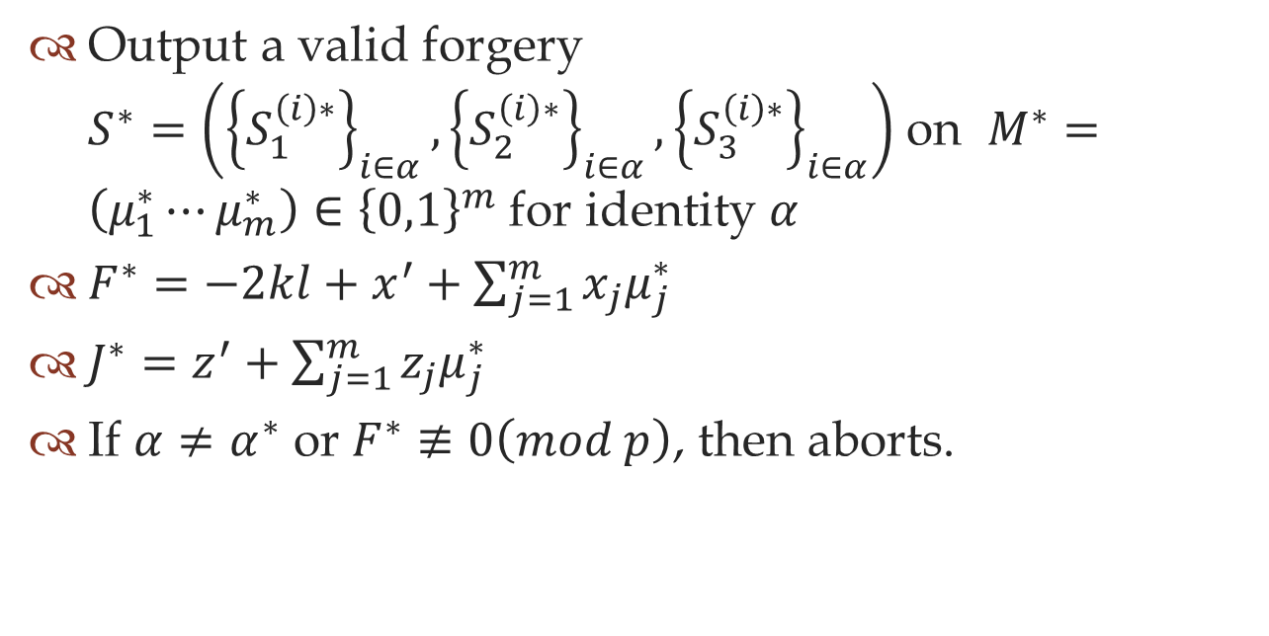
Producing Forgery
Output a valid forgery $S^{∗}=\left({\left\{S_{1}^{\left(i\right)∗}\right\}}_{i∈α},{\left\{S_{2}^{\left(i\right)∗}\right\}}_{i∈α},{\left\{S_{3}^{\left(i\right)∗}\right\}}_{i∈α}\right)$ on $M^{∗}=\left(μ_{1}^{∗}⋯μ_{m}^{∗}\right)∈{\left\{0,1\right\}}^{m}$ for identity $α$
$F^{∗}=−2kl+x^{′}+\sum_{j=1}^{m}{x_{j}μ_{j}^{∗}}$
$J^{∗}=z^{′}+\sum_{j=1}^{m}{z_{j}μ_{j}^{∗}}$
If $α≠α^{∗}$ or $F^{∗}≢0\left(mod p\right)$, then aborts.

Slide 45

Producing Forgery
For some $r_{i}^{∗}, s_{i}^{∗}∈ℤ_{p}$
$S_{1}^{\left(i\right)∗}=g_{2}^{q^{∗}\left(i\right)}T{\left(i\right)}^{r_{i}^{∗}}{\left(v^{′}\prod_{j=1}^{m}{v_{j}^{μ_{j}^{∗}}}\right)}^{s_{i}^{∗}}$
$=g_{2}^{q^{∗}\left(i\right)}g^{f\left(i\right)r_{i}^{∗}}g^{J^{∗}s_{i}^{∗}}$
$S_{2}^{\left(i\right)∗}=g^{−r_{i}^{∗}}$
$S_{3}^{\left(i\right)∗}=g^{−s_{i}^{∗}}$

Slide 46
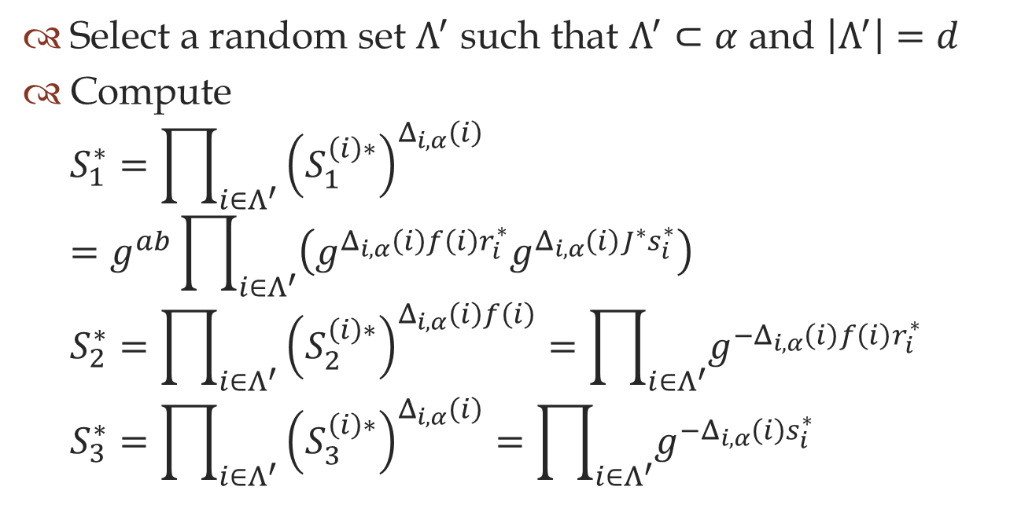
Producing Forgery
Select a random set $Λ^{′}$ such that $Λ^{′}⊂α$ and $\left|Λ^{′}\right|=d$
Compute
$S_{1}^{∗}=\prod_{i∈Λ^{′}}{{\left(S_{1}^{\left(i\right)∗}\right)}^{Δ_{i,α}\left(i\right)}}$
$=g^{ab}\prod_{i∈Λ^{′}}{\left(g^{Δ_{i,α}\left(i\right)f\left(i\right)r_{i}^{∗}}g^{Δ_{i,α}\left(i\right)J^{∗}s_{i}^{∗}}\right)}$
$S_{2}^{∗}=\prod_{i∈Λ^{′}}{{\left(S_{2}^{\left(i\right)∗}\right)}^{Δ_{i,α}\left(i\right)f\left(i\right)}}=\prod_{i∈Λ^{′}}{g^{{−Δ}_{i,α}\left(i\right)f\left(i\right)r_{i}^{∗}}}$
$S_{3}^{∗}=\prod_{i∈Λ^{′}}{{\left(S_{3}^{\left(i\right)∗}\right)}^{Δ_{i,α}\left(i\right)}}=\prod_{i∈Λ^{′}}{g^{{−Δ}_{i,α}\left(i\right)s_{i}^{∗}}}$

Slide 47
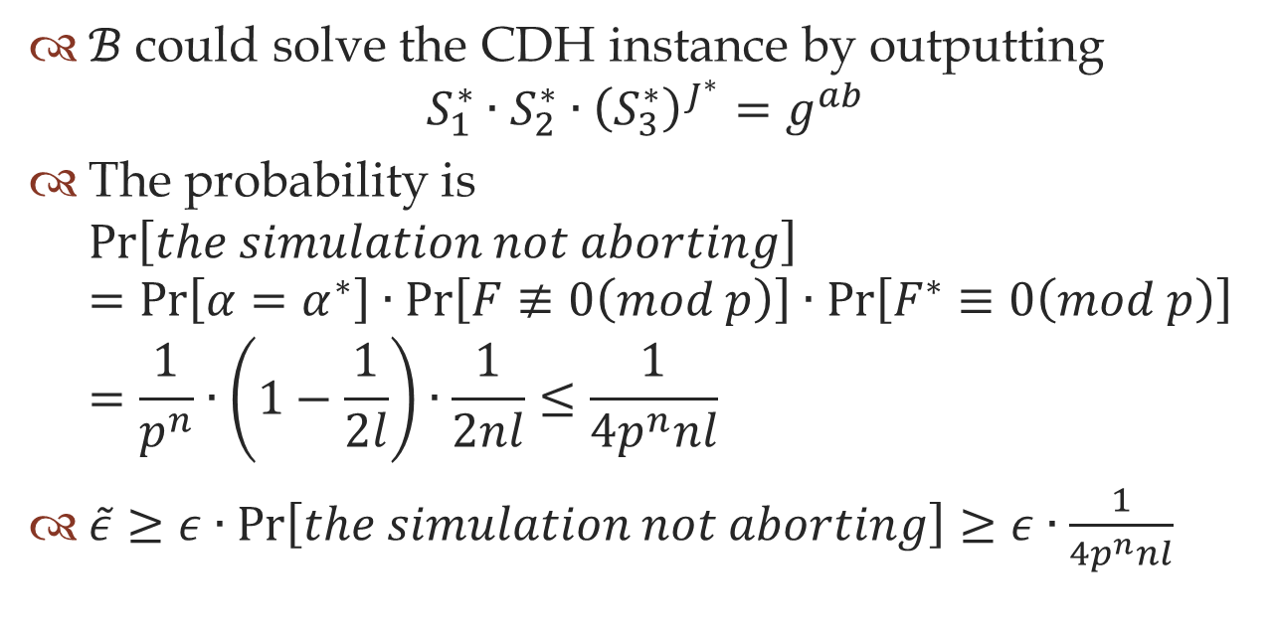
Solving CDH
$ℬ$ could solve the CDH instance by outputting
$S_{1}^{∗}∙S_{2}^{∗}∙{\left(S_{3}^{∗}\right)}^{J^{∗}}=g^{ab}$
The probability is
$\operatorname{Pr}\left[the simulation not aborting\right]$
$=\operatorname{Pr}\left[α=α^{∗}\right]∙\operatorname{Pr}\left[F≢0\left(mod p\right)\right]∙\operatorname{Pr}\left[F^{∗}≡0\left(mod p\right)\right]$
$=\frac{1}{p^{n}}∙\left(1−\frac{1}{2l}\right)∙\frac{1}{2nl}≤\frac{1}{4p^{n}nl}$
$\tilde{ε}≥ε∙\operatorname{Pr}\left[the simulation not aborting\right]≥ε∙\frac{1}{4p^{n}nl}$

Slide 48
Issues
Privacy
Capture and replay

Slide 49
Privacy
No anonymity for signer

Slide 50
Capture and replay
Only secure when forgery of identity can be detected

Slide 51
Conclusion

Slide 52

Conclusion
Allows identity $ω$ to issue a signature that identity $ω^{′}$ can verify
  Provided that $ω$ and $ω^{′}$ are within some distance
Unforgeable against adaptively chosen message attack

Slide 53
Thank you
Question?

Slide 54
References
Dan Boneh and Matthew K. Franklin. Identity-based encryption from the weil pairing. In CRYPTO ’01: Proceedings of the 21st Annual International Cryptography Conference on Advance in Cryptology, page 213-229, London, UK, 2001. Springer-Verlag.
Jin Li and Kwangjo Kim. Attribute-based ring signature. Cryptology ePrint Archive, Report 2008/394, 2008.
Amit Sahai and Brent Waters. Fuzzy Identity-Based encryption. In Advance in Cryptography – EUROCRYPT 2005, page 457-473. 2005.
Siamak F Shahandashti and Reihaneh Safavi-Naini. Threshold attribute-based signatures and their application to anonymous credential systems. Cryptology ePrint Archive, Report 2009/126, 2009.
Brent Waters. Efficient Identity-Based encryption without random oracles. In Advance in Cryptography – EUROCRYPT 2005, page 114-127. 2005.
Piyi Yang, Zhenfu Cao, and Xiaolei Dong. Fuzzy identity based signature. Cryptology ePrint Archive, Report 2008/002, 2008.

