Slide 1
Location Based Services and Privacy Issues
Tsovinar Chugaszyan
Presentation date 07.02.11

Slide 2
Outline
LBS Technologies
Main components
Infrastructure
Applications
Privacy in LBS
Threats and concerns
Solutions for privacy-preserving LBS
Analysis and challenges

Slide 3
Location Based Services
Main idea: utilize the location information of the user in order to provide different services
One of the most important Value-Added Services in the mobile market
The first commercial LBS service: introduced in 2001 by Japanese mobile operator NTT-DoCoMo,

Slide 4
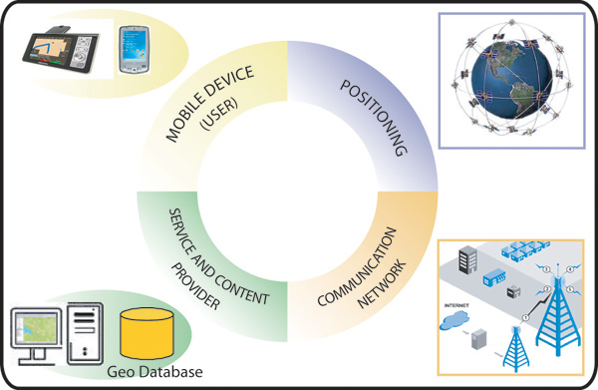
Main Components

Slide 5
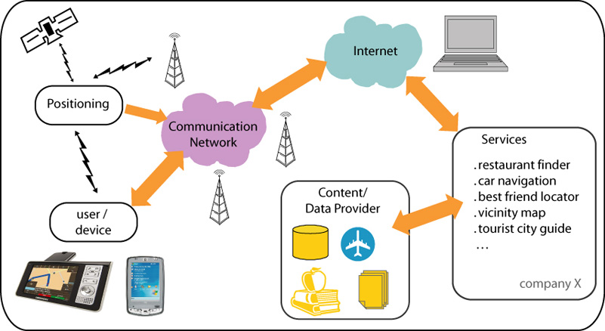
Main data flow between the LBS components

Slide 6
LBS Applications
Categories and examples of applications
Information services – requesting the rearest ATM
Navigation - how to reach the specified target location
Emergency - person who is in a need of ambulance and is lost in woods
Entertainment – social networking, mobile games
Marketing – location-based mobile advertising
Tracking – tracking of postal packages

Slide 7
Privacy and Security Issues
Revealing of sensitive information about an individual or a union. There are already some real life incidents
Social networking platforms: Google Latitude, FourSquere, Gowalla, Facebook raise safety issues of the user's movement tracking records
Misuse of location information may also have commercial purposes

Slide 8
Existing solutions for privacy protection: Legal Frameworks
Aim to protect and preserve the privacy of the user's personal data (e.g. Directive on privacy and electronic communications by The European Parliament and the Council of the European Union)
Main point: the user must be able to control the availability of her location information, i.e. who can access it and for what purposes
Used in conjunction with technical Solutions

Slide 9
Existing solutions for privacy protection: Technical Solutions
The 3 main categories of Privacy-Enhancing Technologies:
Cryptographic Encryption techniques- security mechanisms providing location authentication and authorization.
Pseudonymization techniques- replace the user's actual identity with an artificial one (pseudonym).
Location anonymization techniques-transform the precise location of the user into a cloaked spatial area.

Slide 10
Location Anonymization
Main idea: the exact location information of the user gets transformed into cloaked location areas
Metric: k-anonymity, indicates that the user prefers to be not distinguishable among k users
The most famous model: Trusted Third Party paradigm, which utilizes a middle layer between the mobile device and the database server

Slide 11
Sample privacy-preserving architechture

Slide 12
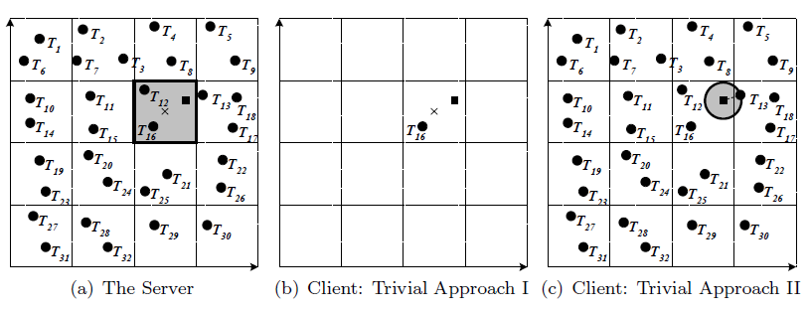
Location anonymization algorithm
Processing of queries

Slide 13
Analysis
TTP Advantages :
suitable for real time applications
requires less operating costs.
TTP Drawbacks :
trust vs. financial obligations
creates risks of compromising the privacy in case trusted party gets attacked

Slide 14
The Main Challenge
The tradeoff between privacy and the quality of service that the LBS can provide.
The strong solution is the one which provides best balance
“….develop customizable privacy protection mechanisms that can help users find a comfortable balance between the extreme of fully disclosed location data and the extreme of completely withheld location data.„(L. Liu)

Slide 15
Special thanks to our tutors and to all reviewers of my work for very helpful remarks

Slide 16
Thank you for your attention!

